Slide 1
Combatting Employee Attrition
A Proof of Concept
Adeniji Oluwagbemiga Daniel

Slide 2

Problem Statement
Employee Attrition Control
Company X has an issue with employee attrition. The Company needs a lasting analytical solution to diagnose the causes and predict the future effects.

Slide 3

Objectives
Employee Attrition Control
An analytical solution to determine: What type of employees are leaving ? Which employees are prone to leave next? This will involve a deep-dive into the data available for existing and exited employees Analytical Skillset: Python for Data Science

Slide 4
Methodology
Analysis
A Cross-analysis Of information of Employees who left the company
A Cross- analysis of individual information of Existing Employees
A Comparison of both analyses to draw out useful insights

Slide 5
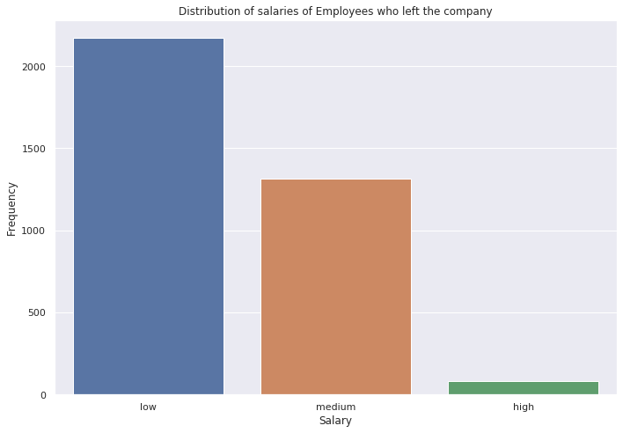
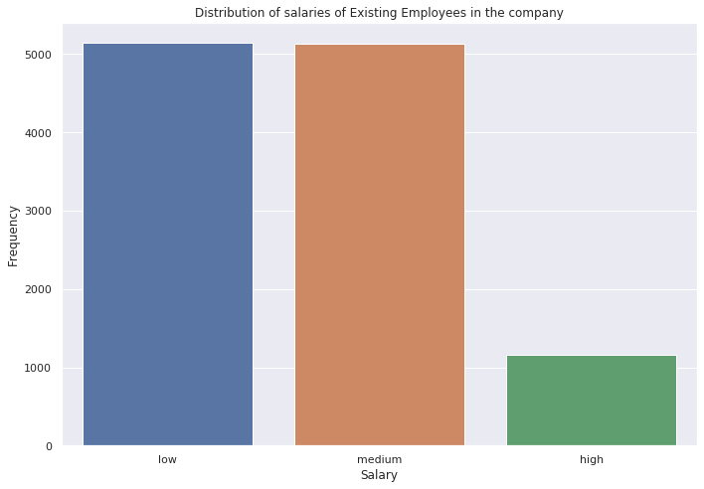
Methodology
Employees who left the company

Slide 6
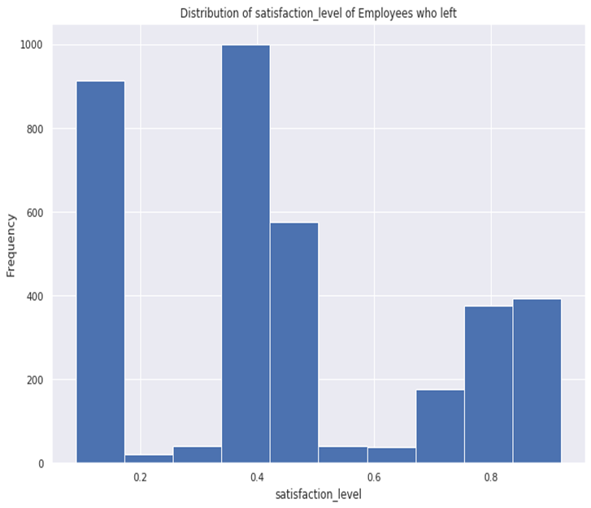
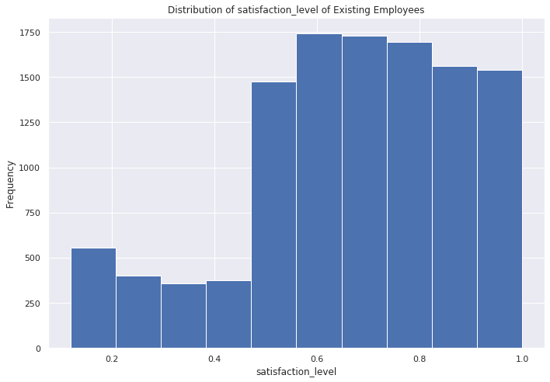
Methodology
Employee Satisfaction Level

Slide 7
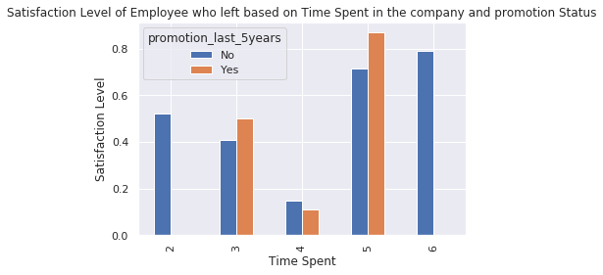
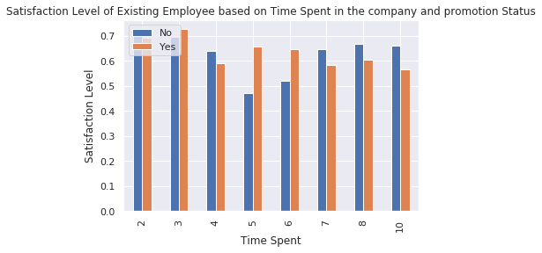
Methodology
Employees Satisfaction Level (2)

Slide 8
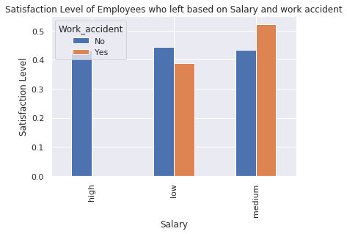
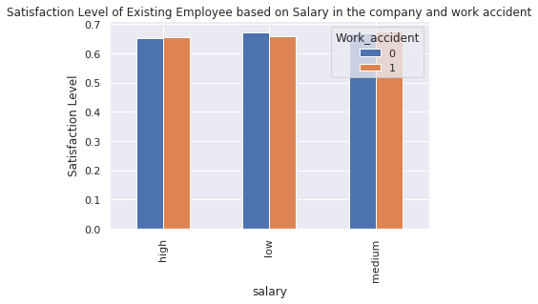
Methodology
Employees Satisfaction Level (3)

Slide 9
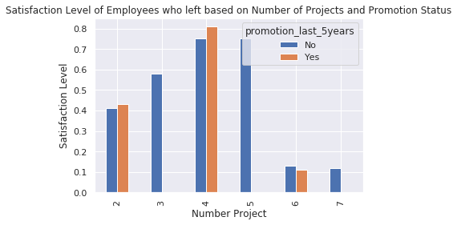
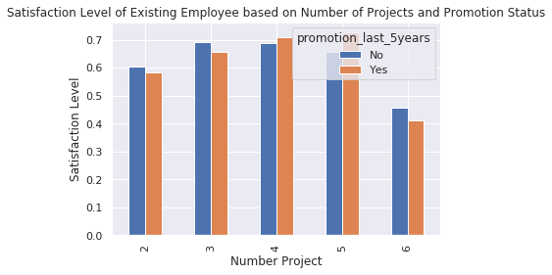
Methodology
Employees Satisfaction Level (4)

Slide 10
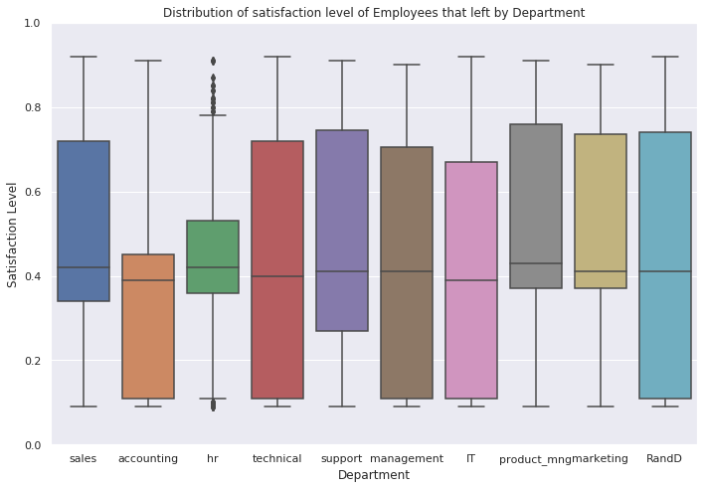
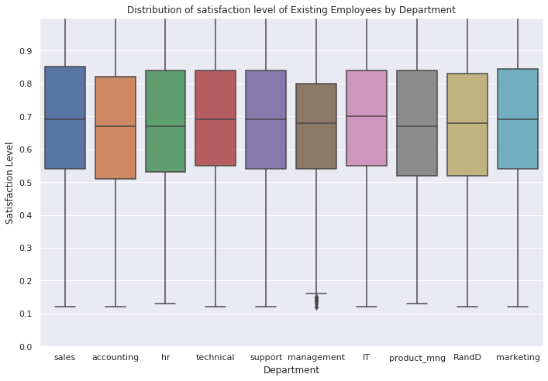
Methodology
Employees Satisfaction Level (4)

Slide 11
Observations and Recommendations (1)
After examining the data of Employees existing and those who left the company concurrently, the following insights and observations were found.
The average satisfaction level of employees who left was below average of 45% while that of existing employees was around 70%
Around 65% of employees who left had a satisfaction level below 45%, 99.6% of them where not promoted within the last 5 years.
Existing Employees having a satisfaction level below average of 45% and have not been promoted within the last 5 years are prone to leave the company.
Company X is therefore characterised by:
Low satisfaction level
Infrequent promotion

Slide 12
Observations and Recommendations (2)
Secondly,
Employees who left that spent 4 years working in the company had a low satisfaction level below 45% and were not promoted.
Irrespective of the time spent working in the company, the existing employees have a moderate satisfaction level and were promoted within the last five years excluding employees that spent 5 years In the company.

Slide 13
Observations and Recommendations (3)
Thirdly,
The salary framework of those that left the company that had work accident was within low and medium range and their satisfaction level was estimated to be 50%.
The salary range was well distributed ranging from low, medium and high which improved their level of satisfaction.
This means the company’s salary structure was well maintained for those with work accidents.
Lastly,
The number of projects embarked on of employees who left exceeded 4, their satisfaction level began to decline and they were not promoted within the last 5 years
An increase in the number of projects resulting in a decline in satisfaction level and promotion status can be seen as a factor as to why employees are leaving the company.
An increase in the number of projects resulting in a decline in satisfaction level and promotion status can be seen as a factor as to which employees are prone to leave the company.

Slide 14
Recommendations
To control attrition, the company should identify and compensate employees in diverse ways such as promotion or an increase in salary so as to increase their satisfaction level and loyalty to the company.
To prevent future attrition, the satisfaction level of employees should be maintained high and the number of projects allocated to an employee should be considered and not be enormous to ensure employees don’t lose enthusiasm working, which may in turn lead to them leaving the company.
The number of projects assigned should be highly considered and critically looked at

Slide 15
THANK YOU

